Slide 1
New European Regulation N 548/14
on power transformers
Angelo Baggini, angelo.baggini@unibg.it, Bergamo University - Engineering Department
Via Marconi 5, 24044 Dalmine (BG) – Italy

Slide 2
Policy instruments
Energy performance
metric categories
Reference standards
A quite long EU story
Subject and scopes
Power transformer (re)classification and metrics
Medium power transformer prescriptions
Large power transformer prescriptions
From theory to practice

Slide 3
Power Transformers
Energy performance standards
and regulations around the world
Policy instruments
1.

Slide 4
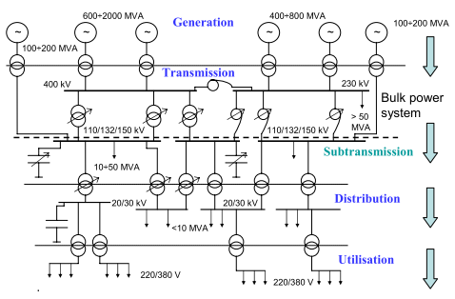
Effect of multiple transformation
0,98 x 0,98 x 0,98 x 0,98 x 0,98 = 0,90

Slide 5

Policy instruments
Minimum Energy Performance Standards (MEPS)
Voluntary or mandatory product labelling
Financial incentives, subsidies and tax breaks
Funding of demonstration projects and research activities

Slide 6
Country or Region | Rated frequency | Reference standards | EP Index | Notes
Australia and New Zealand | 50 Hz | IEC | Efficiency @ 50% load | Mandatory MEPS
Brazil | 60 Hz | IEC | Losses @ 50% load | Draft MEPS for dry type
Canada | 60 Hz | NEMA IEEE | Efficiency @ 50% load | Mandatory MEPS for dry type Voluntary for liquid filled
China | 50 Hz | IEC | Losses @ 100% load | Mandatory MEPS
European Union | 50 Hz | IEC | Losses @ 100% load (S_{R} < 3150 kVA) PEI (SR ≥ 3150 kVA) | Mandatory MEPS
India | 50 Hz | IEC | Losses @ 100% load and Losses @ 50% load | Mandatory MEPS and labelling scheme for certain liquid immersed
Israel | 50 Hz | IEC | Losses @ 100% load | Mandatory MEPS
Japan | 50-60 Hz | IEC | Total loss @ 40% (SR ≤ 500 kVA) Total loss @ 50% (SR > 500 kVA) | Mandatory labelling
Korea | 60 Hz | IEC | Efficiency @ 50% load | Mandatory MEPS
Mexico | 60 Hz | IEEE | Efficiency @ 100% load | Mandatory for liquid filled
USA | 60 Hz | IEEE | Efficiency @ 50% load | Mandatory MEPS and labelling
Vietnam | 50 Hz | IEC | Efficiency @ 50% load | Mandatory MEPS

Slide 7
Power Transformers
Energy performance standards
and regulations around the world
Energy performance
metric categories
2.

Slide 8
Energy performance metric categories
Maximum LL and NLL
@ maximum load
Maximum total LL+NLL
@ a particular load factor
Minimum efficiency
@ a particular load factor

Slide 9
Power Transformers
Energy performance standards
and regulations around the world
Reference standards
3.

Slide 10




Reference standards
IEC 60076-X series: Power transformers
EN 50588-1: Medium power transformers 50 Hz, with highest voltage for equipment not exceeding 36 kV - Part 1: General requirements
EN 50629: Energy performance of large power transformers (Um > 36 kV or Sr ≥ 40 MVA)
IEEE C57.12.90: Test code for liquid-immersed distribution, power and regulating transformers
IEEE C57.12.91: Test code for dry-type distribution and power transformers
IEEE C57.12.00: General requirements for Liquid immersed distribution, power and regulating transformers
NEMA TP 2-2005: Standards test methods for measuring the energy consumption of distribution transformers

Slide 11
Reference standards
Backgrounds
Rated power definition
Reference temperature
Rated frequency
Rated maximum voltages of the equipment

Slide 12
Power Transformers
Energy performance standards
and regulations around the world
Reference standards
Rated power definition
3.1

Slide 13
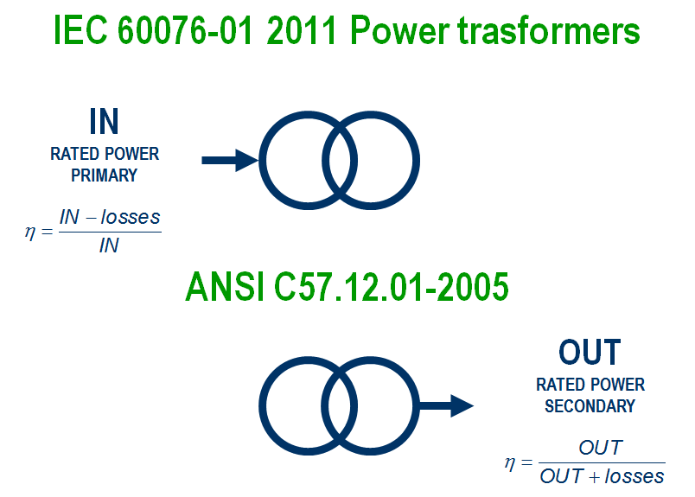
Backgrounds
Rated power definition

Slide 14
Backgrounds
Rated power definition
Standard | IEC | IEEE
Rated power | 50 kVA | 48.6 kVA
No load losses | 0.190 kW
Load Losses | 1.250 kW
Eff. equation | (50 – (0.190 + 1.250))/50 | 50 / (48.6 + (0.190 + 1.250)
Efficiency (%) | 97.12% | 97.12%
Comparison between IEC and IEEE efficiency definition (same losses)

Slide 15
Backgrounds
Rated power definition
Standard | IEC | IEEE
Rated power | 50 kVA
Efficiency (%) | 97.12%
Eff. equation | (50 – TL)/50 | 50 / (50 + TL)
No load losses + Load Losses (TL) | 1.440 kW | 1.482 kW
Comparison between iec and ieee efficiency definition (same rated power and efficiency)

Slide 16
Power Transformers
Energy performance standards
and regulations around the world
Reference standards
Reference temperature
3.2

Slide 17
Backgrounds
Reference temperature
Standard | Ref. Temperature
IEC | 75°C
EU Regulation | 75°C
IEEE | 85°C
US DOE | 55°C
Comparison between reference temperatures for liquid immersed transformers

Slide 18
Power Transformers
Energy performance standards
and regulations around the world
Reference standards
Rated frequency
3.3

Slide 19
Backgrounds
Rated frequency
At lower frequencies (50 Hz):
  more core material (and conductor material consequently)
  larger and more expensive transformers
At higher frequencies (60 Hz):
  both the NLL and LL feature higher eddy current losses
Suitable conversion factors
To take note of the energy performances of each transformer at its specific operating conditions

Slide 20
Power Transformers
Energy performance standards
and regulations around the world
Reference standards
Rated voltages
3.4

Slide 21
Backgrounds
Rated maximum voltages of the equipment
the lower the V_{R} of the LV winding
the higher the V_{R} of the HV winding
the higher the expected losses

Slide 22
EU Regulation N 548/14
and EU standardisation
A quite long story
4.

Slide 23
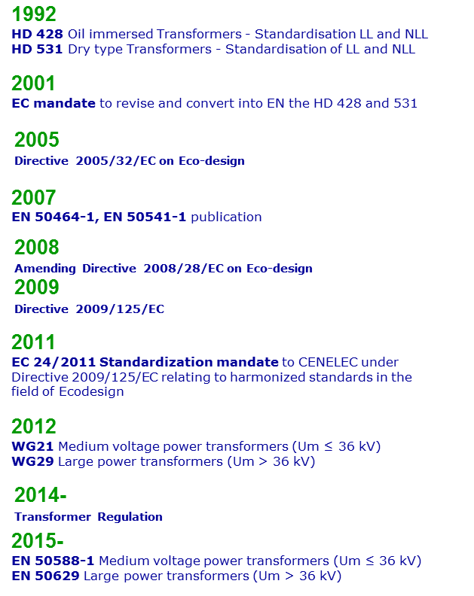
A quite long story

Slide 24


From Regulation to Standardisation
… and back
24

Slide 25
1992
HD 428 Oil immersed Transformers - Standardisation of LL and NLL
HD 531 Dry type Transformers - Standardisation of LL and NLL
2001
EC mandate to revise and convert into EN the HD 428 and 531
(as consequence of the Thermie Project)
2007
EN 50464-1, EN 50541-1 publication
2011
EC 24/2011 Standardization mandate to CENELEC under Directive 2009/125/EC relating to harmonized standards in the field of Ecodesign
2015
EN50588-1 Medium voltage power transformers (Um ≤ 36 kV)
EN50629 Large power transformers (Um > 36 kV)

Slide 26
EU Transformer Regulation
Background
Directive 2005/32/EC on Eco-design*
establishes a framework for
  the setting of ecodesign requirements for energy-using products
  amending Council Directive 92/42/EEC and Directives 96/57/EC and 2000/55/EC of the European Parliament and of the Council
Amending Directive 2008/28/EC on Eco-design
implements powers conferred on the Commission
Directive 2009/125/EC**
  recasts of the Ecodesign Directive 2005/32/EC
  extension to energy related products
* also referred as ‗EuP Directive or Energy using Products Directive
** also referred as Energy Related Products Directive or ERP Directive

Slide 27
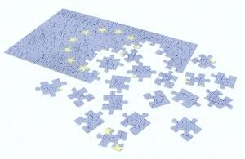
European Union
CEN-CENELEC
Voluntary
Tech standards
(HD and EN)
  Citizens
EC and/or National governements
Mandatory
Directives
    Countries
Laws
    Citizens
Regulations
    Citizens

Slide 28
Where are we in the regulatory process?
EU Transformer Regulation
Feb 2011
Preparatory study concluded by VITO
Nov 2011
Selection of contractor for IA study
Informal discussions with stakeholders
April 2012
Ecodesign Consultation Forum
May to Sep 2012
Drafting of the Impact Assessment
Before the end of 2012
Opinion of the Impact Assessment Board
Q3 - 2013
Commission inter-service consultation
Autumn 2013
WTO Consultation
December 13th 2103
Vote in Regulatory Committee
May 2014
EC final appruval and Adoption - Publication on OJEU - Entry into force
July 1st 2015
Transformer Ecodesign Regulation TIER 1

Slide 29
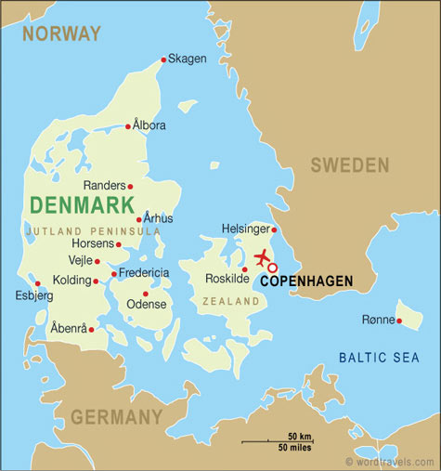
For example

Slide 30
EU Regulation N 548/14
Subject and scope
5.

Slide 31
COMMISSION REGULATION (EU) No 548/2014
of 21 May 2014
on implementing Directive 2009/125/EC of the European Parliament and of the Council with regard to small, medium and large power transformers
Subject matter and scope
This Regulation establishes ecodesign requirements for placing on the market or putting into service power transformers with a minimum power rating of 1 kVA used in 50 Hz electricity transmission and distribution networks or for industrial applications. The Regulation is only applicable to transformers purchased after the entry into force of the Regulation.
http://eur-lex.europa.eu/legal-content/EN/TXT/?uri=OJ:L:2014:152:TOC
July 1st 2015
July 1st 2021
TIER 1
TIER 2
2018
31

Slide 32

Proposed exceptions to the regulation
COMMISSION REGULATION (EU) No 548/2014
of 21 May 2014
on implementing Directive 2009/125/EC of the European Parliament and of the Council with regard to small, medium and large power transformers
Exclusions:
instrument transformers, specifically designed to supply measuring instruments, meters, relays and other similar apparatus,
transformers with low-voltage windings specifically designed for use with rectifiers to provide a DC supply,
transformers specifically designed to be directly connected to a furnace
transformers specifically designed for offshore applications and floating offshore applications
transformers specially designed for emergency installations
transformers and auto-transformers specifically designed for railway feeding systems,
earthing or grounding transformers, this is, three-phase transformers intended to provide a neutral point for system grounding purposes
traction transformers mounted on rolling stock, this is, transformers connected to an AC or DC contact line, directly or through a converter, used in fixed installations of railway applications
starting transformers, specifically designed for starting three-phase induction motors so as to eliminate supply voltage dips
testing transformers, specifically designed to be used in a circuit to produce a specific voltage or current for the purpose of testing electrical equipment
welding transformers, specifically designed for use in arc welding equipment or resistance welding equipment
transformers specifically designed for explosion-proof and underground mining applications
transformers specifically designed for deep water (submerged) applications
medium Voltage (MV) to Medium Voltage (MV) interface transformers up to 5 MVA
large power transformers where it is demonstrated that for a particular application, technically feasible alternatives are not available to meet the minimum efficiency requirements set out by this Regulation
large power transformers which are like for like replacements in the same physical location/installation for existing large power transformers, where this replacement cannot be achieved without entailing disproportionate costs associated to their transportation and/or installation,

Slide 33
EU Regulation N 548/14
Power transformer (re)classification
and metrics
6.

Slide 34
Power transformer (re-)classification
Um
L
Large
36 kV
EN50629
M
Medium
1,1 kV
EN50588-1
1000 MVA
5 kVA
40 MVA
Sr

Slide 35
Energy performance classification
Max losses and min efficiency
Um
MINIMUM EFFICIENCY
L
36 kV
MAXIMUM
LOSSES
M
Medium
1,1 kV
5 kVA
3150 kVA
40 MVA
Sr
Notes:
Mettere in ordine e dire (solo a voce o con sovraimpressione tutti i vantaggi di un approccio e dell’altro)

Slide 36
Maximum LL and NLL
Unification for future developments of scale economies, interchangeability, etc...
NLL and LL never greater than a certain value regardless of the applied load. A minimum level of performance is assured whatever the level of loading applied to the transformer.
Maximum losses are not dependent from the application but only from the product
The knowledge of the load profile to be used for ex ante optimization is typically not enough to reach the theoretical optimum
Flexibility related to efficiency approaches is a pro but leaves more space than a loss list to distorted behavior of the market and frauds etc.
Setting a mandatory maximum level of load and no load losses does not mean that it’s not possible to standardize or simply to choose other values optimizing each specific application.

Slide 37
Energy efficiency
100
Energy efficiency (%)
* Usually 40–50%
0
20
40
60
80
100
Load (%)
Notes:
Le perdite dovute al carico che hanno luogo in un trasformatore sono funzione della corrente e vengono normalmente distinte in principali e addizionali.
Facendo riferimento ai soli avvolgimenti le prime sono quelle che si possono calcolare in base alla resistenza ohmica degli avvolgimenti stessi (quella misurabile in c.c.), e le seconde sono genericamente definite, in modo pragmatico, quelle che sommate alle prime forniscono le perdite globali rilevabili sperimentalmente in una data condizione di funzionamento.
In linea generale, si può affermare che le perdite addizionali sono principalmente dovute alla disuniforme distribuzione della corrente nelle sezioni degli avvolgimenti conseguente all'azione di flussi alternati che interessano lo spazio occupato dagli stessi. Tali flussi, risultando concatenati in misura diversa con i vari filetti elementari in cui si può idealmente suddividere ciascun conduttore, generano f.e.m. indotte, che hanno l'effetto macroscopico di rarefare o addensare la corrente attraverso la sezione.
Qualora l'avvolgimento fosse costituito da più sezioni poste in parallelo, oltre al fenomeno dell'addensamento della corrente, si manifestano anche perdite addizionali per circolazione, in quanto può accadere che sui conduttori elementari siano indotte f.e.m. diverse.
Altri fenomeni che possono causare perdite addizionali sono quelli legati alle deformazioni delle linee di campo del flusso magnetico che investendo diversamente le varie parti dell'avvolgimento provocano ulteriori disuniformità nella distribuzione della corrente.
Le principali caratteristiche delle perdite addizionali riguardano le sue relazioni con la frequenza della corrente e con la resistività del materiale.
Per quanto riguarda il primo aspetto (dipendenza dalla frequenza) si ha che le perdite addizionali non hanno, in funzione del tipo di avvolgimento considerato, una dipendenza univoca dalla frequenza, mentre la principale ne è sempre indipendente [1,2].
Ciò risulta di particolare rilevanza in presenza di onde di corrente non sinusoidali. Il problema può essere analizzato servendosi dell'analisi di Fourier essendo lecito applicare il principio di sovrapposizione degli effetti poichè i fenomeni possono considerarsi lineari. Le perdite totali dovute al carico possono quindi essere calcolate sommando i contributi di perdita dovuti alle singole armoniche.
Questo modo di procedere risulta molto comodo poichè lo studio della distribuzione di corrente in regime alternato non sinusoidale è spesso molto laborioso, e non sempre possibile per via analitica mentre è relativamente semplice in regime sinusoidale.
Per il secondo punto (dipendenza dalla resistività) si ha ancora che le perdite addizionali non sono univocamente legate a questa, mentre le principali ne sono direttamente proporzionali; di conseguenza le prime possono crescere o decrescere al crescere della temperatura, a seconda del tipo di fenomeno considerato, mentre la seconda cresce sempre. Ciò ha importanza soprattutto agli effetti della determinazione delle perdite in sede di collaudo, poichè esse vengono misurate a temperatura ambiente e vanno riportate alla temperatura di riferimento.
Quando sono in gioco correnti elevate, le perdite nelle connessioni non possono essere trascurate, ma necessitano di un'analisi specifica. I flussi magnetici di dispersione degli avvolgimenti possono investire altre parti conduttrici, per esempio le armature, i tiranti o, quando presente, la cassa del trasformatore, provocando anche in essi perdite per effetto Joule.
Questi aspetti che, in ragione della consistente aleatorietà legata ai percorsi seguiti dal flusso di dispersione introducono consistenti difficoltà nel tentativo di modellazione analitica, presentano fortunatamente un peso molto modesto rispetto alle perdite totali.

Slide 38
Minimum efficiency
neutral technological metric, flexibility in designing
optimized transformer for specific application
optimal loading point may not coincide with the average loading
procurement practice:
    LPTs few very important units specified by expert professionals one by one
    MPTs produced in thousands of units for the general market
100
Efficiency (%)
0
0
20
40
60
80
100
Load(%)

Slide 39
EU Regulation N 548/14
Medium power transformer prescriptions
7.

Slide 40
Medium Power Transformer
Um
L
36 kV
MS
Medium
1,1 kV
5 kVA
3150 kVA
40 MVA
Sr

Slide 41
Max Losses Liquid immersed Sr ≤3150 kVA
EU Regulation 548/2104
36
36
NLL +15%
LL +10%
NLL +20%
LL +15%
24
Tables
3, 4, 5
NLL +10%
LL +10%
Um (kV) primary winding
1,1
EN50588-1 e EU Regulation 548/2104
Tables
3, 4, 5
NLL +15%
LL +10%
NA
0
0
1,1
24
36
Um (kV) secondary winding

Slide 42
Max Losses Liquid immersed Sr ≤3150 kVA
EU Regulation 548/2104
Sr | AAAo | AAo | Ao | Bo | Co
kVA | W | W | W | W | W
25 | 35 | 63 | 70 | 90 | 100
50 | 45 | 81 | 90 | 110 | 125
100 | 75 | 131 | 145 | 180 | 210
160 | 105 | 189 | 210 | 260 | 300
250 | 150 | 270 | 300 | 360 | 425
315 | 180 | 324 | 360 | 440 | 520
400 | 220 | 387 | 430 | 520 | 610
500 | 260 | 459 | 510 | 610 | 720
630 | 300 | 540 | 600 | 730 | 860
800 | 330 | 585 | 650 | 800 | 930
1000 | 390 | 693 | 770 | 940 | 1100
1250 | 480 | 855 | 950 | 1150 | 1350
1600 | 600 | 1080 | 1200 | 1450 | 1700
2000 | 730 | 1305 | 1450 | 1800 | 2100
2500 | 880 | 1575 | 1750 | 2150 | 2500
3150 | 1100 | 1980 | 2200 | 2700 | 3150
Sr | Vcc | Ak | Bk | Ck
kVA | % | W | W | W
25 | 4 | 600 | 725 | 900
50 |  | 750 | 875 | 1100
100 |  | 1250 | 1475 | 1750
160 |  | 1700 | 2000 | 2350
250 |  | 2350 | 2750 | 3250
315 |  | 2800 | 3250 | 3900
400 |  | 3250 | 3850 | 4600
500 |  | 3900 | 4600 | 5500
630 | 4 or 6 | 4600 | 5400 | 6500
800 | 6 | 6000 | 7000 | 8400
1000 |  | 7600 | 9000 | 10500
1250 |  | 9500 | 11000 | 13500
1600 |  | 12000 | 14000 | 17000
2000 |  | 15000 | 18000 | 21000
2500 |  | 18500 | 22000 | 26500
3150 |  | 23000 | 27500 | 33000
Load losses
NO load losses
Oil immersed 1,1-24 kV
Excluding pole mounted
TIER 1 - July 1st 2015
EN50588-1
Notes:
Segnare il minimo della regulation nei due periodi
E confronto con le vecchie
Aggiunto il 25 kVA
Le vecchie NON avevano AAA0 e AA0
C’erano un E0 e un D0 (E0 era già sparito con l’amendment)
Avevano associato il livello di rumore
C’era un Dk che
poi con l’amendment era già andato via
I vecchi PERDITE NORMALI (E0 DK) E PERDITE RIDOTTE (D0 BK)

Slide 43
Max Losses Liquid immersed Sr ≤3150 kVA
EU Regulation 548/2104
Sr | AAAo | AAo | Ao
kVA | % | % | %
25 | 100 | 180% | 200%
50 |  | 180% | 200%
100 |  | 175% | 193%
160 |  | 180% | 200%
250 |  | 180% | 200%
315 |  | 180% | 200%
400 |  | 176% | 195%
500 |  | 177% | 196%
630 |  | 180% | 200%
800 |  | 177% | 197%
1000 |  | 178% | 197%
1250 |  | 178% | 198%
1600 |  | 180% | 200%
2000 |  | 179% | 199%
2500 |  | 179% | 199%
3150 |  | 180% | 200%
Sr | Vcc | Ak | Bk | Ck
kVA | % | % | % | %
25 | 4 | 100 | 121%
50 |  |  | 117%
100 |  |  | 118%
160 |  |  | 118%
250 |  |  | 117%
315 |  |  | 116%
400 |  |  | 118%
500 |  |  | 118%
630 | 4 or 6 |  | 117%
800 | 6 |  | 117%
1000 |  |  | 118%
1250 |  |  | 116% | 142%
1600 |  |  | 117% | 142%
2000 |  |  | 120% | 140%
2500 |  |  | 119% | 143%
3150 |  |  | 120% | 143%
Load losses
NO load losses
Liquid immersed 1,1-24 kV
Excluding pole mounted
TIER 1 - July 1st 2015
EN50588-1
Notes:
Segnare il minimo della regulation nei due periodi
E confronto con le vecchie
Aggiunto il 25 kVA
Le vecchie NON avevano AAA0 e AA0
C’erano un E0 e un D0 (E0 era già sparito con l’amendment)
Avevano associato il livello di rumore
C’era un Dk che
poi con l’amendment era già andato via
I vecchi PERDITE NORMALI (E0 DK) E PERDITE RIDOTTE (D0 BK)

Slide 44
Max Losses Dry type Sr ≤3150 kVA
EU Regulation 548/2104
Rated power | P_{K} |  |  | P_{O}
 | A_{k} | B_{k} | AAA_{O} | AA_{O} | A_{O}
kVA | W | W | W | W | W
≤ 50 | 1500 | 1700 | 115 | 180 | 200
100 | 1800 | 2050 | 160 | 252 | 280
160 | 2600 | 2900 | 230 | 360 | 400
250 | 3400 | 3800 | 300 | 468 | 520
400 | 4500 | 5500 | 430 | 675 | 750
630 | 7100 | 7600 | 630 | 990 | 1100
800 | 8000 |  | 750 | 1170 | 1300
1000 | 9000 |  | 890 | 1395 | 1550
1250 | 11000 |  | 1035 | 1620 | 1800
1600 | 13000 |  | 1265 | 1980 | 2200
2000 | 16000 |  | 1495 | 2340 | 2600
2500 | 19000 |  | 1780 | 2790 | 3100
3150 | 22000 |  | 2185 | 3420 | 3800
Dry type 1,1-24 kV
TIER 1 - July 1st 2015
EN50588-1

Slide 45
Max Losses Dry type Sr ≤3150 kVA
EU Regulation 548/2104
Rated power | P_{K} |  |  | P_{O}
 | A_{k} | B_{k} | AAA_{O} | AA_{O} | A_{O}
kVA | % | % | % | % | %
≤ 50 | 100% | 113% | 100% | 157% | 174%
100 |  | 114% |  | 158% | 175%
160 |  | 112% |  | 157% | 174%
250 |  | 112% |  | 156% | 173%
400 |  | 122% |  | 157% | 174%
630 |  | 107% |  | 157% | 175%
800 |  |  |  | 156% | 173%
1000 |  |  |  | 157% | 174%
1250 |  |  |  | 157% | 174%
1600 |  |  |  | 157% | 174%
2000 |  |  |  | 157% | 174%
2500 |  |  |  | 157% | 174%
3150 |  |  |  | 157% | 174%
Dry type 1,1-24 kV
TIER 1 - July 1st 2015
EN50588-1

Slide 46
Max Losses Sr ≤3150 kVA
EU Regulation 548/2104
Sr | A_{k} | AAA_{O}
kVA | % | %
≤ 50 | 200% | 256%
100 | 144% | 213%
160 | 153% | 219%
250 | 145% | 200%
400 | 161% | 239%
630 | 218% | 286%
800 | 205% | 288%
1000 | 196% | 297%
1250 | 183% | 314%
1600 | 171% | 324%
2000 | 168% | 311%
2500 | 158% | 297%
3150 | 147% | 299%
Dry type / Liquid immersed 1,1-24 kV
TIER 1 - July 1st 2015

Slide 47
Medium Power Transformer
Um
L
36 kV
ML
Medium
1,1 kV
5 kVA
3150 kVA
40 MVA
Sr

Slide 48
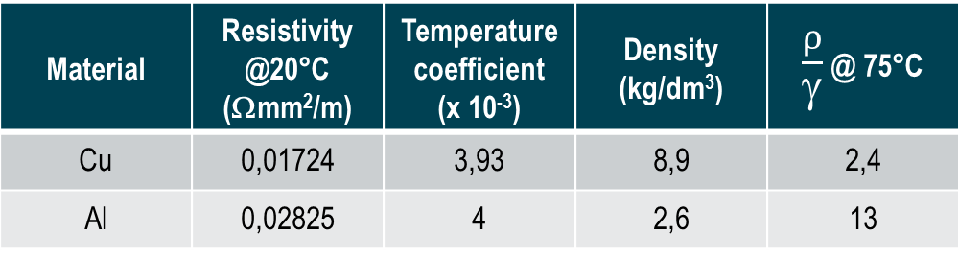
Minimum efficiency
Peak Efficiency Index
$$\text{PEI}\text{ = 1 }\text{−}\frac{\text{2(}{\text{P}}_{\text{0}}\text{+}{\text{P}}_{\text{c}\text{0}}\text{)}}{{\text{S}}_{\text{r}}\sqrt{\frac{{\text{P}}_{\text{0}}\text{+}{\text{P}}_{\text{c}\text{0}}}{{\text{P}}_{\text{k}}}}}$$
P0 = no load losses*
Pc0 = electrical power required by the cooling system for no load operation
Pk = load losses* corrected to reference temperature**
Sr = rated power of the transformer on which Pk is based
* measured at rated voltage and rated frequency, on the rated tap
** 20 °C + Average winding rise (i.e. 90 °C for OD cooled transformers, 85 °C for ON or OF cooled transformers)
Notes:
take into account also energy performances of units required to transform reactive power only
have an index not depending from the application but related to the product only

Slide 49
Minimum efficiency
Peack efficiency index
Also energy performances of units required to transform reactive power only
not depending from the application but related to the product only
mismatch between the no load and load loss ratio which minimizes the transformer cost and the one which optimizes the energy performance during service

Slide 50


Minimum efficiency
Peak Efficiency Index
100
Efficiency (%)
0
20
40
60
80
100
Load(%)
50
Notes:
The peak efficiency index is a unit-less metric, which was developed as a regulatory option for the European ecodesign process. Such index includes both no-load and load losses, but the equation is written in such a way that it does not require a specified loading point. Instead, the index finds the point where the no-load loss equals the load loss, and calculates the value. This approach has an advantage over others, because it does not require prescribing or implying a loading point.
At the same time, considering that in a competitive market environment all manufacturers are trying to minimize their costs, prescribing only minimum values for the PEI can be somehow risky. In fact, there may be a mismatch between the no load and load loss ratio which minimizes the transformer cost and the one which optimizes the energy performance during service (provided that in both cases the minimum PEI value is fulfilled). For this reason, it is important that transformer users prescribe suitable capitalization figures or specify minimum efficiency values at certain load factors in order to obtain the highest energy savings. The importance of this issue is higher for smaller units, while larger power transformers tend to be already today state of the art for what concerns efficiency.

Slide 51
EU Regulation 548/14
3 ph transformers with Sr >3150 kVA
PEAK EFFICIENCY INDEX
Liquid immersed
Dry type
Sr | PEI (%)
(kVA) | A | AA
4000 | 99,465 | 99,532
5000 | 99,483 | 99,588
6300 | 99,510 | 99,571
8000 | 99,535 | 99,593
10000 | 99,560 | 99,615
12500 | 99,588 | 99,640
16000 | 99,615 | 99,663
20000 | 99,639 | 99,684
25000 | 99,657 | 99700
31500 | 99,671 | 99,712
40000 | 99,684 | 99,724
Sr | Peak efficiency (%)
(kVA) | A | AA
4000 | 99,348 | 99,382
5000 | 99,354 | 99,387
6300 | 99,356 | 99,389
8000 | 99,357 | 99,390
10000 | 99,357 | 99,390

Slide 52
EU Regulation N 548/14
Large power transformer prescriptions
8.

Slide 53
Medium Power Transformer
Um
L
Large
36 kV
M
1,1 kV
5 kVA
3150 kVA
40 MVA
Sr

Slide 54
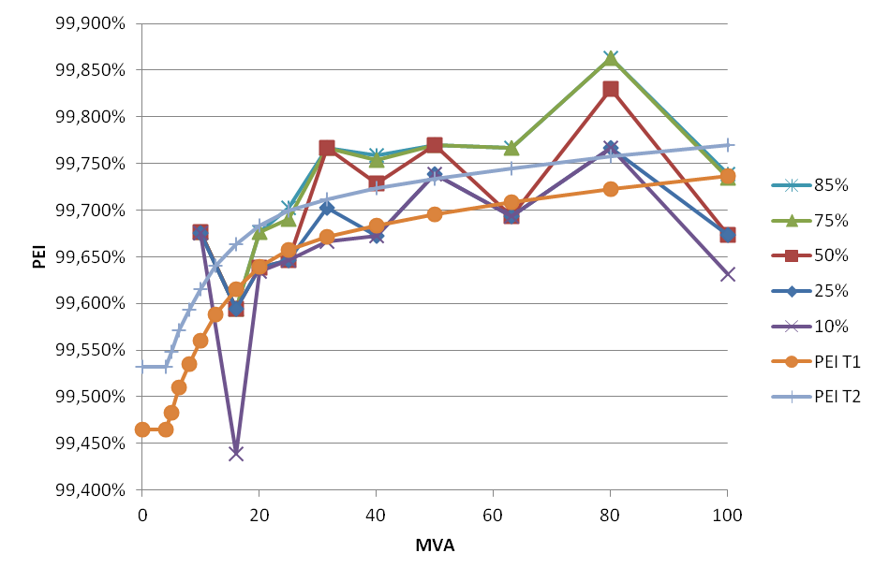
EU Regulation 548/14
Large power trasformers
Data collection
Analysis of data collected
2493 - 8650 Units
422 - 617 different designs
Approx. installed in the last 10 years
From:
Croatia, France, Germany, Ireland, Italy, Norway, Poland, Portugal, Romania, Spain, Sweden, UK

Slide 55
EU Regulation 548/14
Large power trasformers - PEI trend
Real state of art
More transportation and installation costraints Relatively few units
Good R2
Bad R2
Very numerous units
Less transportation and installation costraints
Sometime far from state of art

Slide 56
EU Regulation 548/14
Large power trasformers - PEI trend
Linear
Regulation
Portion
100 MVA
Log
Regulation Portion

Slide 57
EU Regulation 548/14
Large power trasformers - PEI trend
Sr (MVA) | PEI – T1 (%) | PEI – T2 (%)
≤ 4 | 99,465 | 99,532
5 | 99,483 | 99,588
6,3 | 99,510 | 99,571
8 | 99,535 | 99,593
10 | 99,560 | 99,615
12,5 | 99,588 | 99,640
16 | 99,615 | 99,663
20 | 99,639 | 99,684
25 | 99,657 | 99,700
31,5 | 99,671 | 99,712
40 | 99,684 | 99,724
50 | 99,696 | 99,734
63 | 99,709 | 99,745
80 | 99,723 | 99,758
≥ 100 | 99,737 | 99,770
Liquid immersed
Notes:
A floor for efficiency performance
Figures take into consideration the need to remove “distortions”
T1 is based on the results of the survey, approx 25%
The T2, approx 50% of the survey

Slide 58
EU Regulation N 548/14
From theory to practice
9.

Slide 59
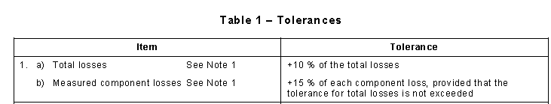
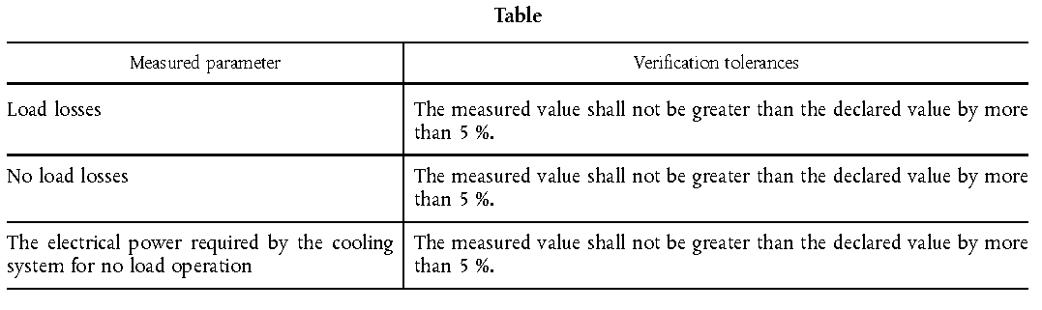
Tolerances
IEC 60076-1
EU 548/15

Slide 60
… and this is the theory, practically…
Measurement uncertainties
Production tolerances
Annex III Verification procedure
When performing the market surveillance checks referred to in Article 3(2) of Directive 2009/125/EC, the authorities of the Member States shall apply the following verification procedure for the requirements set out in Annex I.
[…] The verification tolerances set out in this Annex relate only to the verification of the measured parameters by Member States authorities and shall not be used by the manufacturer or importer as an allowed tolerance to establish the values in the technical documentation.
Measured parameter | Verification tolerances
Load losses | The measured value shall not be greater than the declared value by more than 5 %.
No load losses
The electrical power required by the cooling system for no load operation

Slide 61
Policy instruments
Energy performance
metric categories
Reference standards
A quite long EU story
Subject and scopes
Power transformer (re)classification and metrics
Medium power transformer prescriptions
Large power transformer prescriptions
From theory to practice

Slide 62

Thank you
Angelo Baggini
Università di Bergamo
Dipartimento di Ingegneria
Viale Marconi 5,
24044 Dalmine (BG) Italy
email: angelo.baggini@unibg.it
For more information please contact
ECD Engineering Consulting and Design
Via Maffi 21 27100 PAVIA Italy

